Slide 1
AWS EC2 & EBS 2019
PHANI KISHORE LANKA

Slide 2
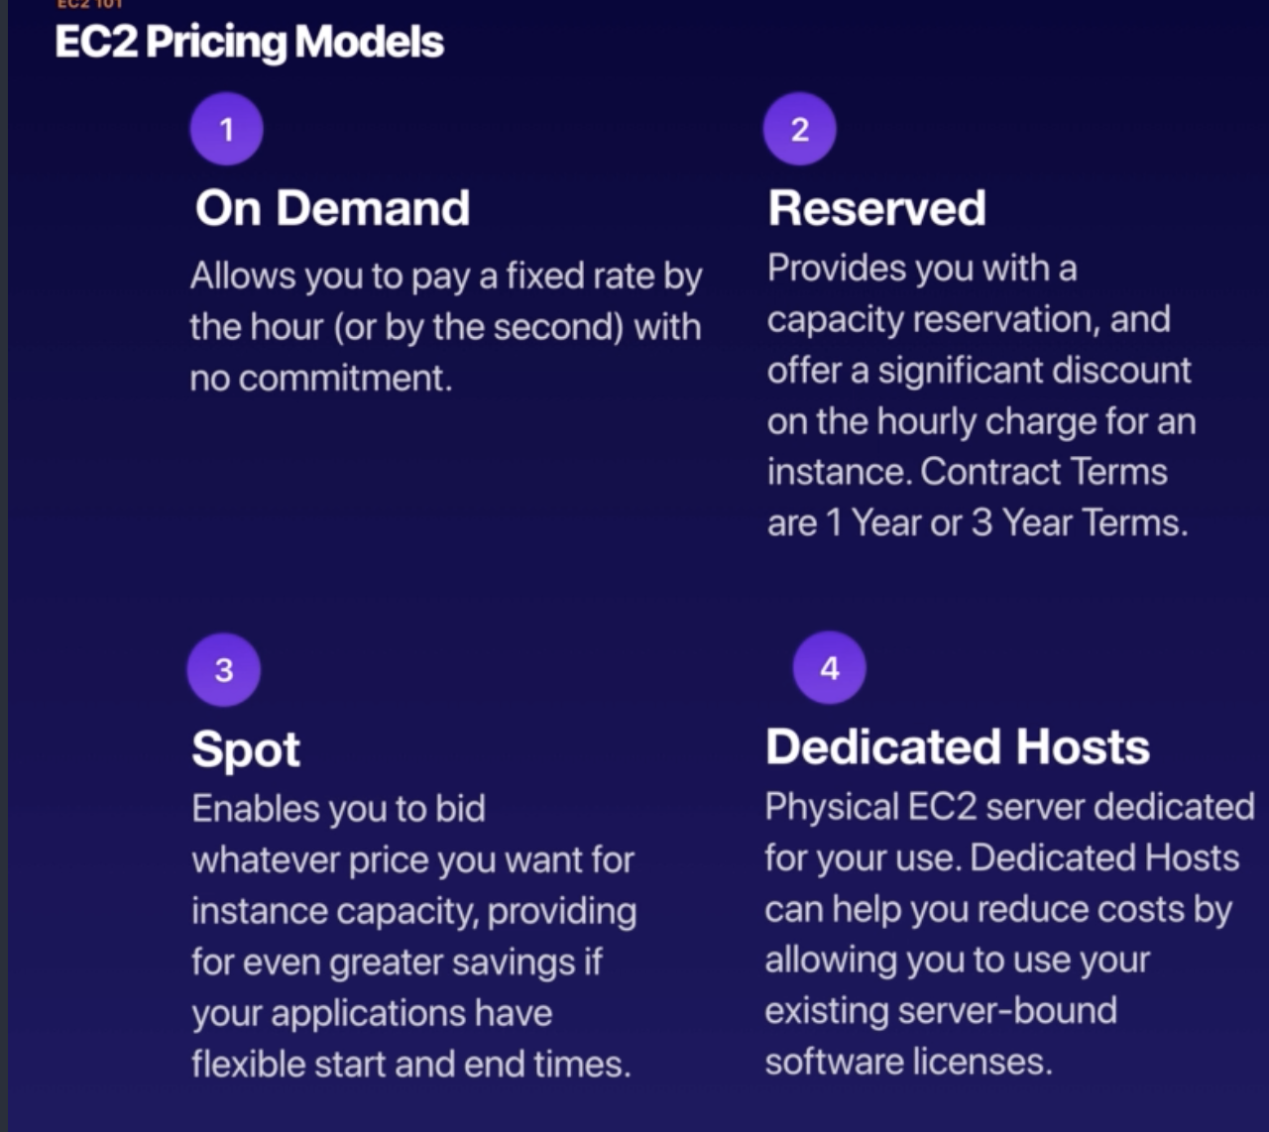

EC2 Pricing Models

Slide 3
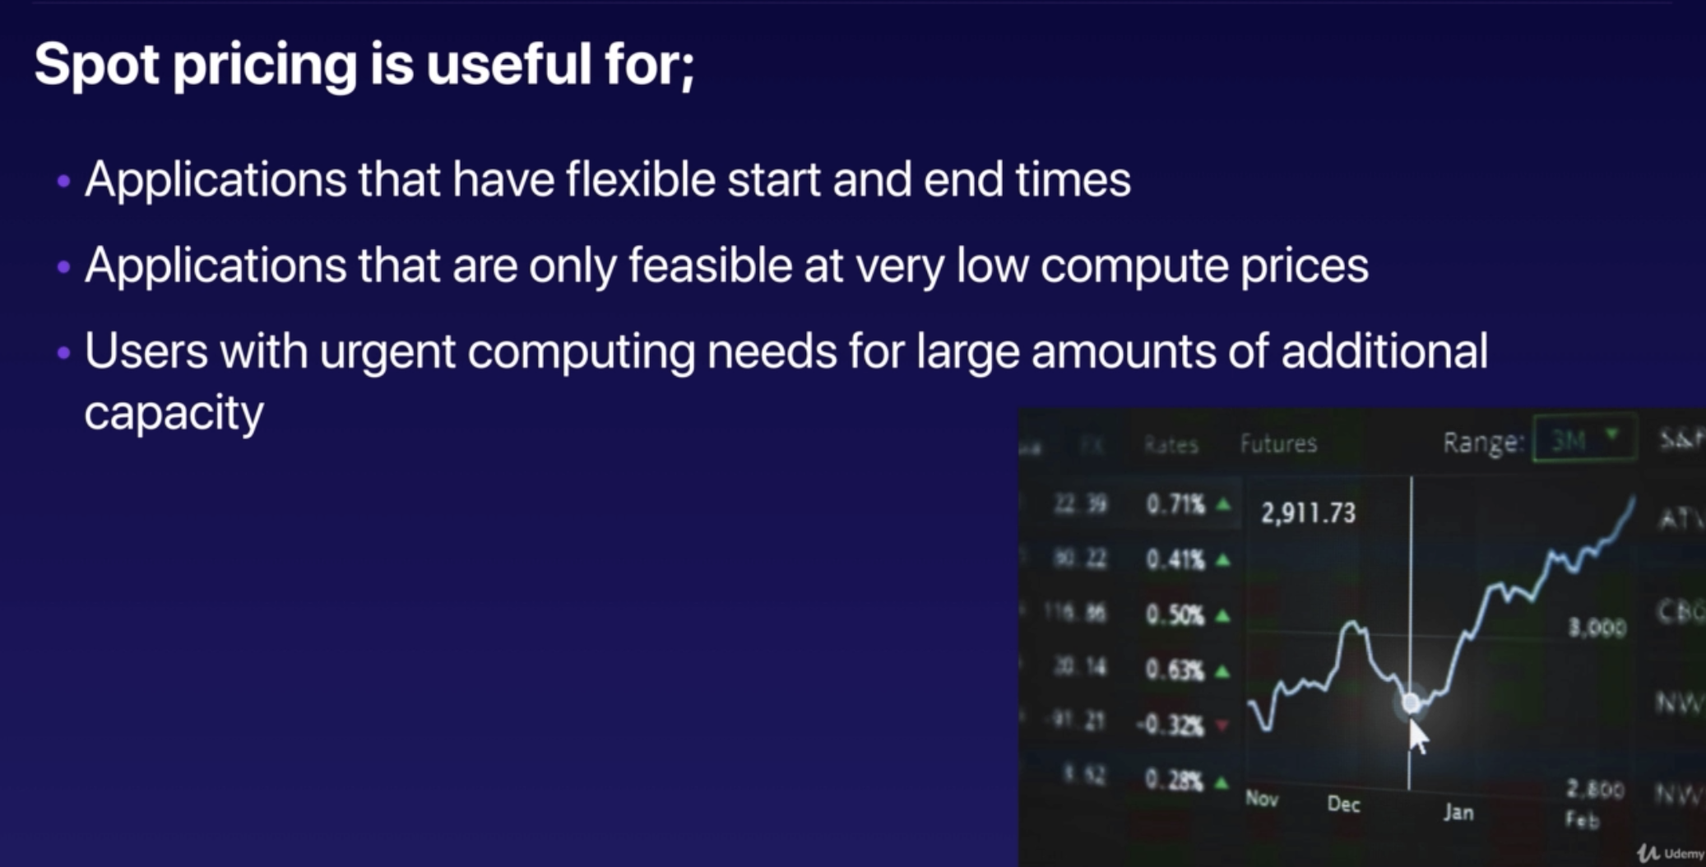
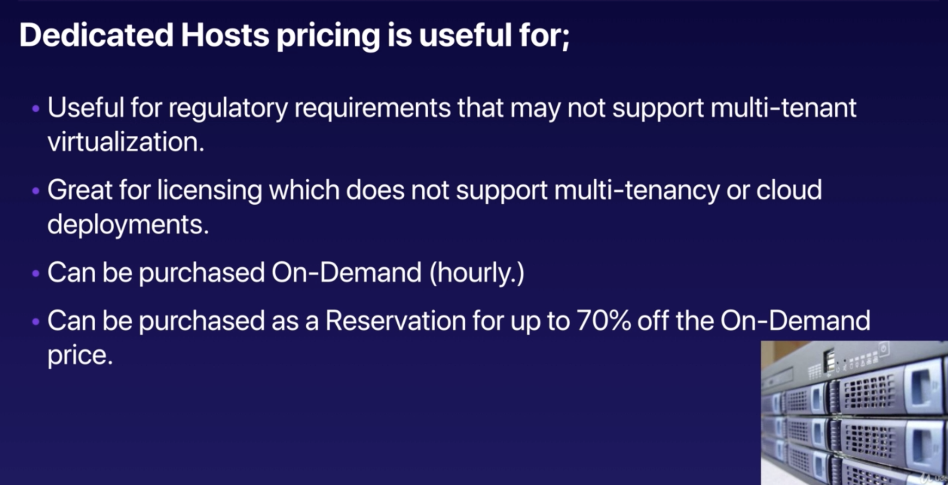

Slide 4
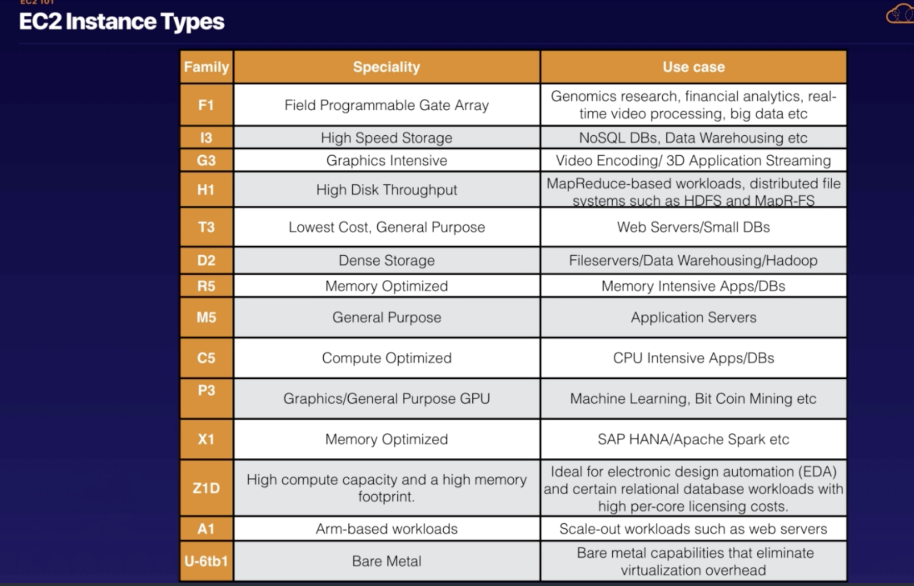


Slide 5
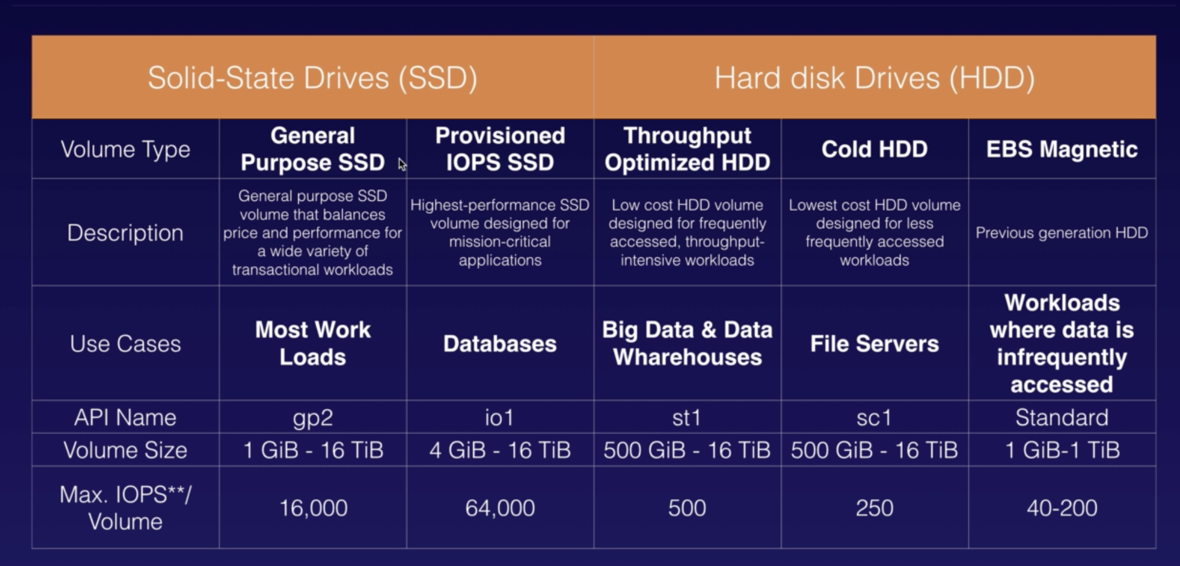
EBS Types

Slide 6
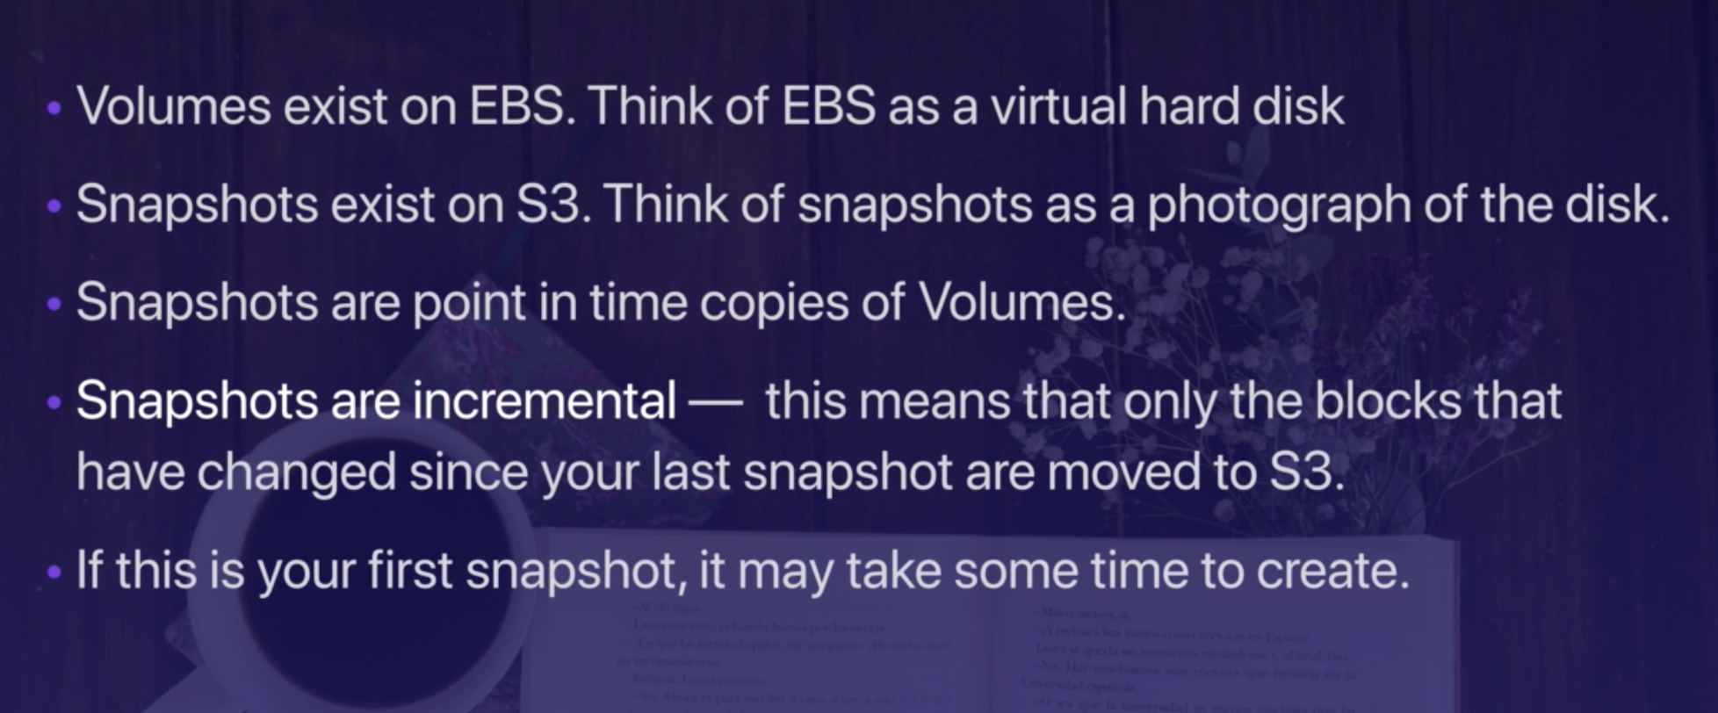
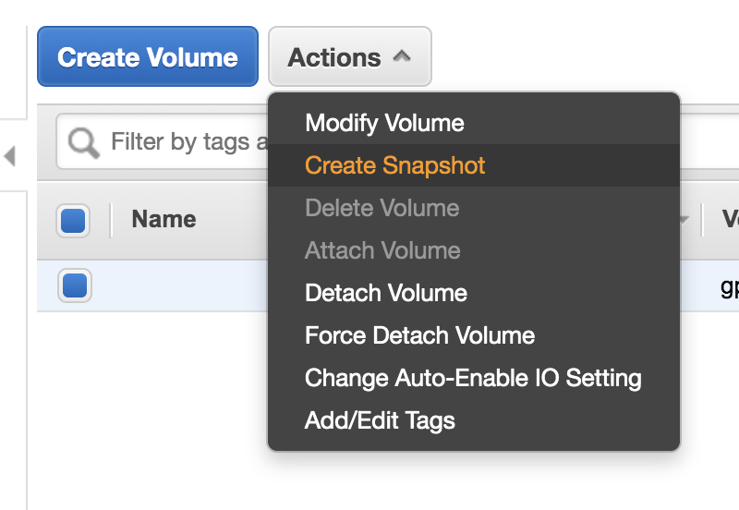
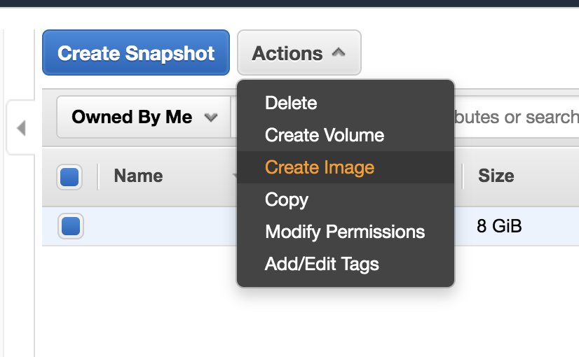
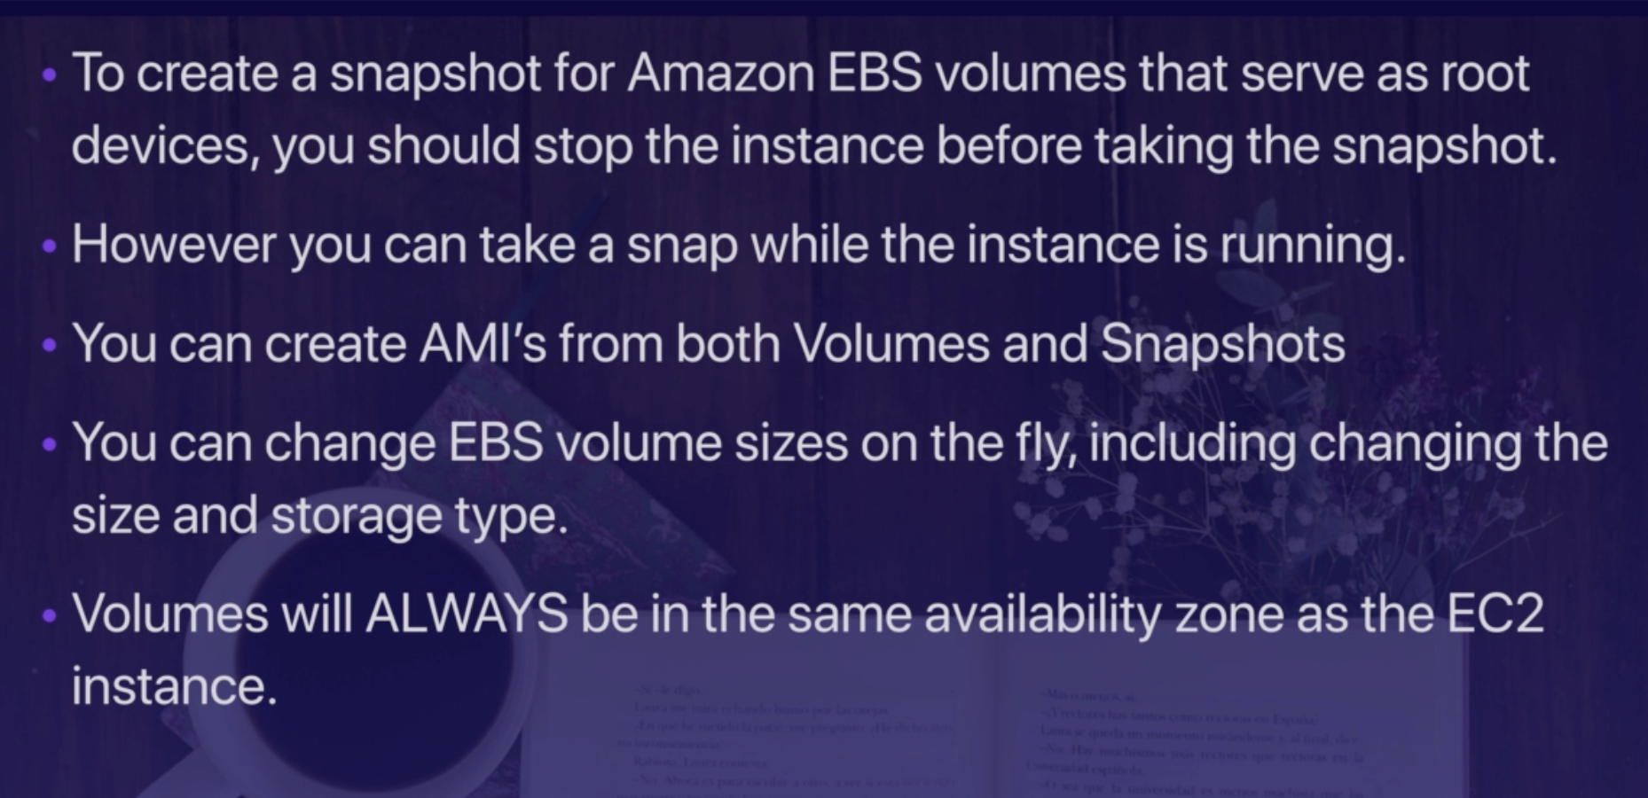
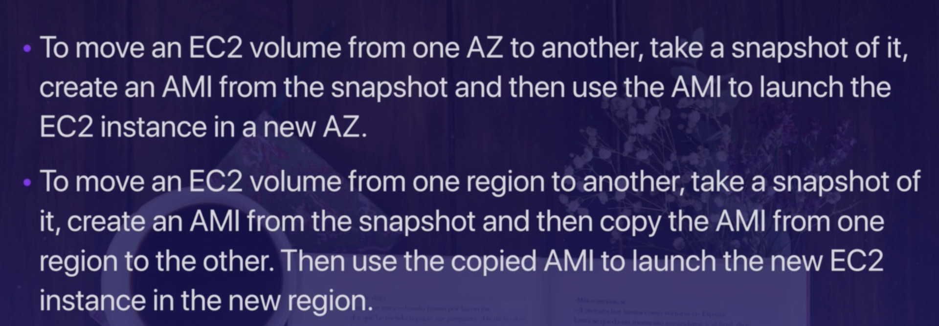
EBS –Important

Slide 7
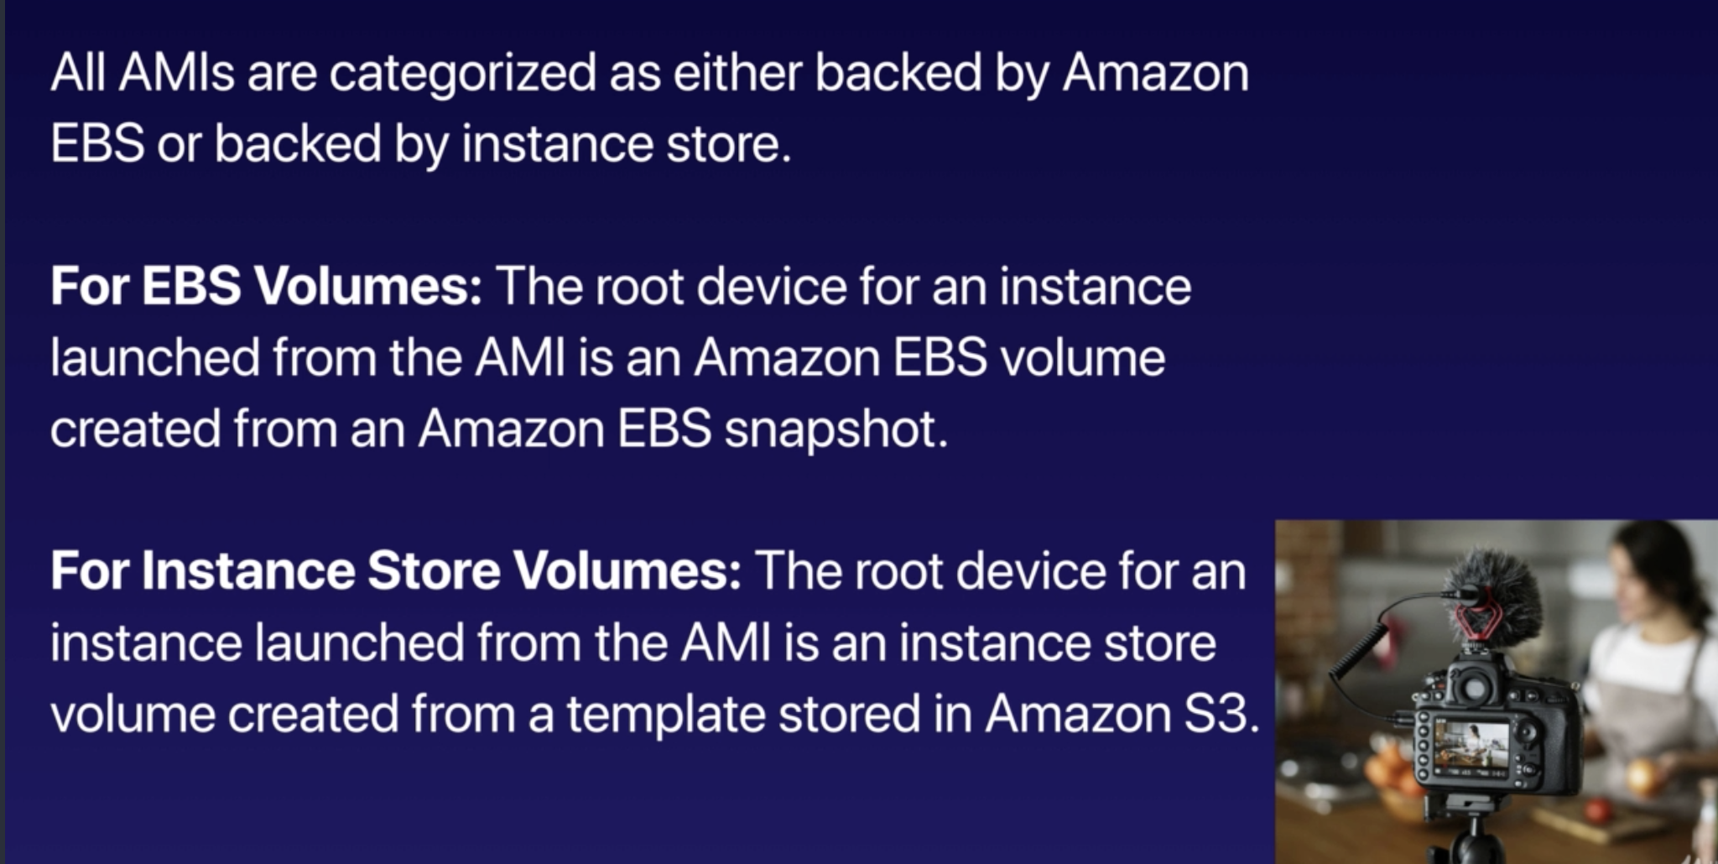
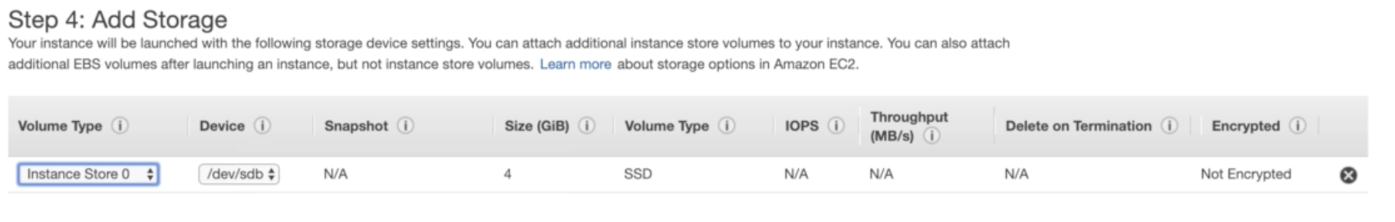
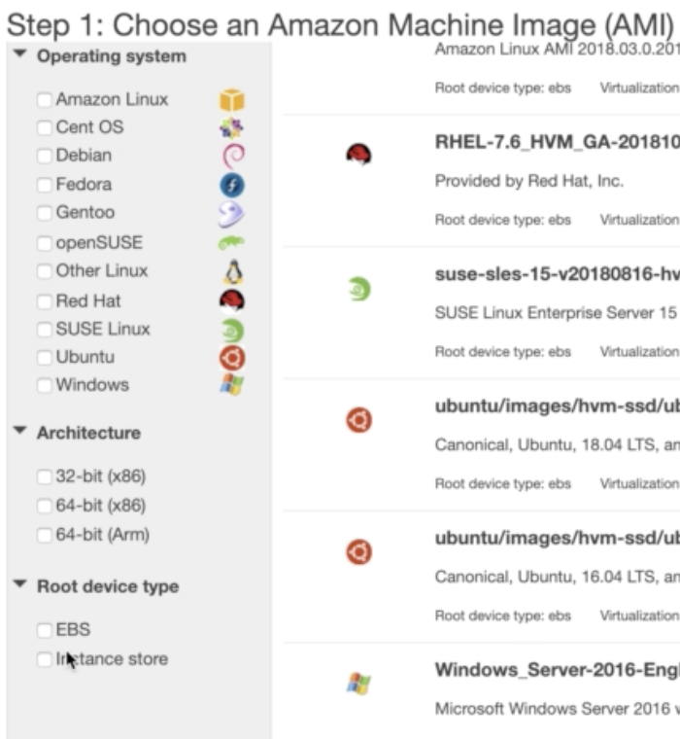
EBS important
You have to declare all instance store volumes during
EC2 Creation only. You cannot see instance Store volumes
In the EC2 → Volumes, You can only see EBS Volumes.
EBS Data is Persistent, If you stop/start , you will getback data
Instance store is created from template, its not persistent,
If you stop start the data doesn’t come back.
By Default Root Volumes are deleted after termination, but
In case of EBS, You can tell aws not do delete on termination.
Delete on Termination is NA for Instance Store.

Slide 8
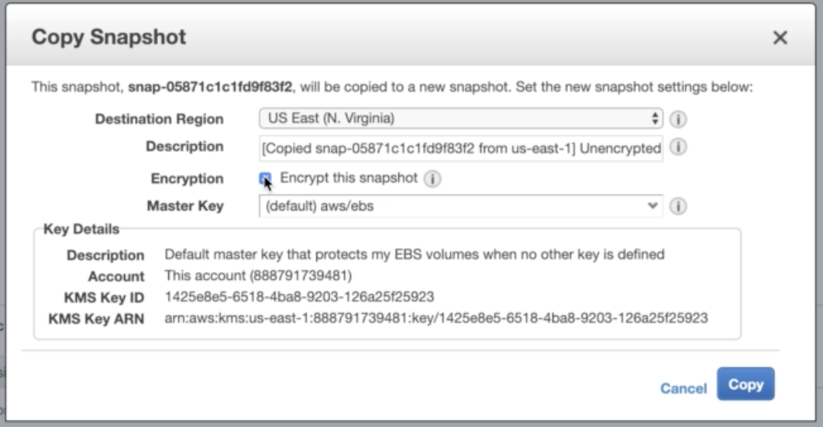
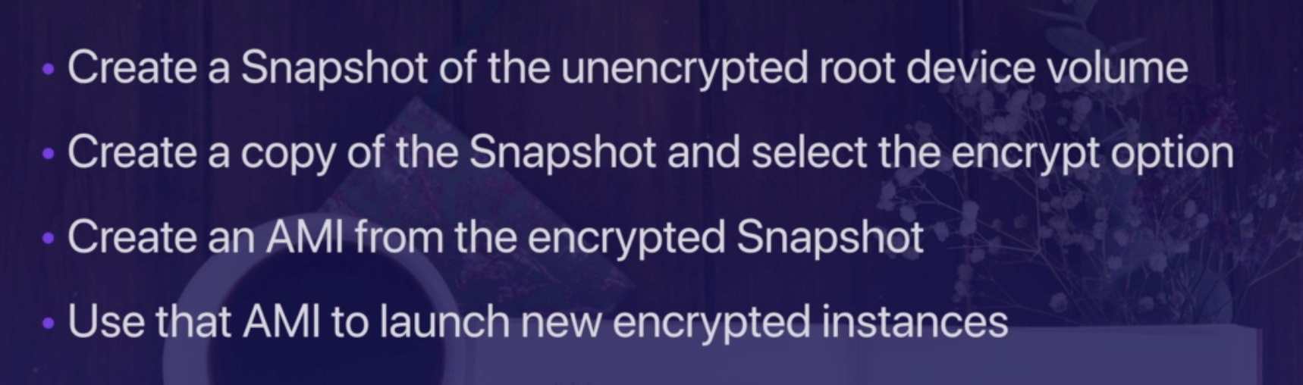
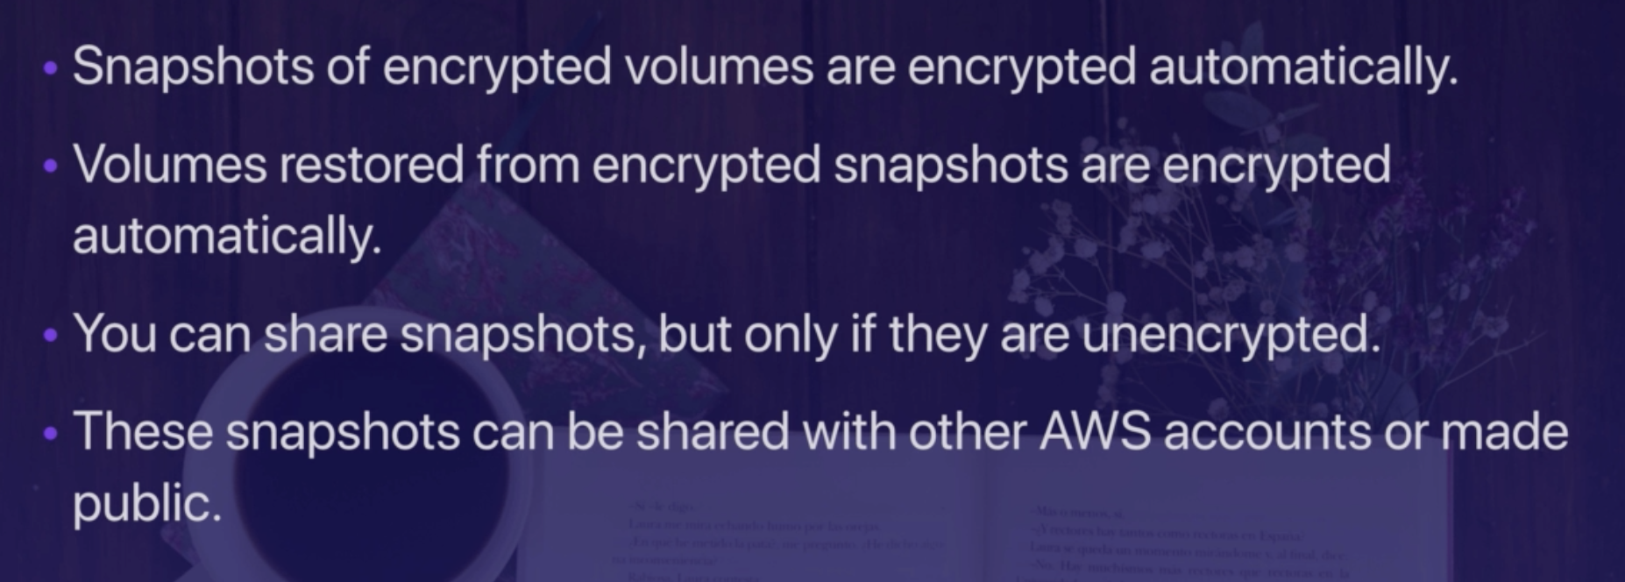
Encryption is only on the FS, Not the Data.
EBS → Root Volume, Not Encrypted by default.
You can encrypt root volume by Following Steps.

Slide 9
EC2 Termination Protection Plan
Termination Protection will only enable accidentail termination from CLI,API,From Console,
If you go to instance and shutdown , instance will terminate if you put shutdown on instance termination.
What does the following command do with respect to the Amazon EC2 security groups? ec2-revoke Revoke Security Group Ingress
Answer:- Removes 1-2 Rules from SG

Slide 10
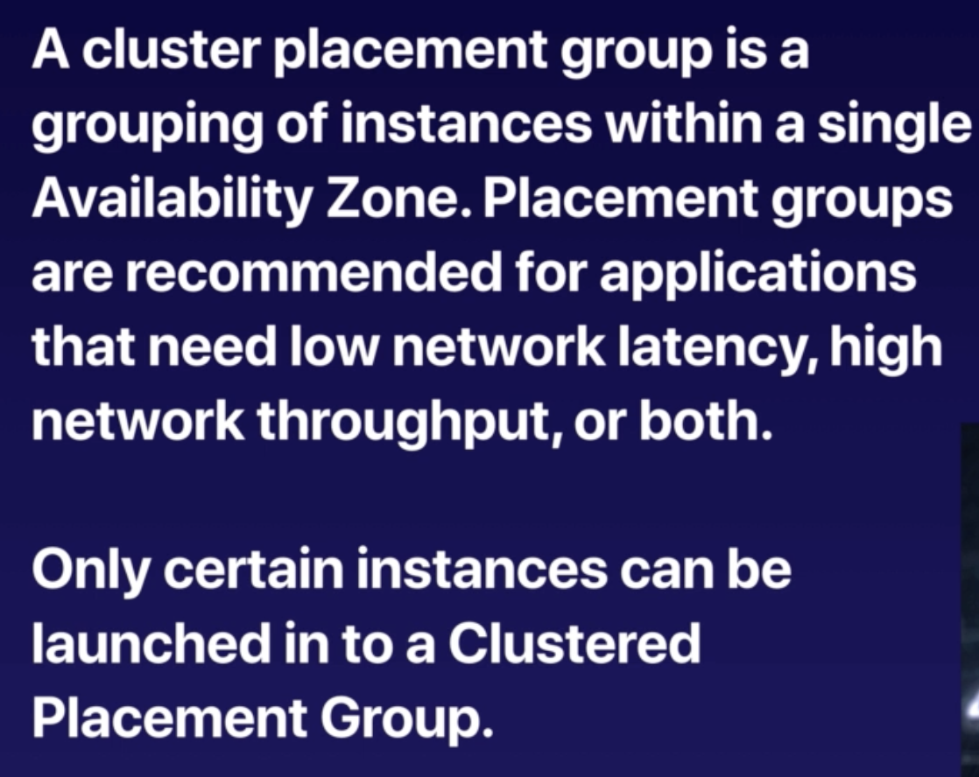
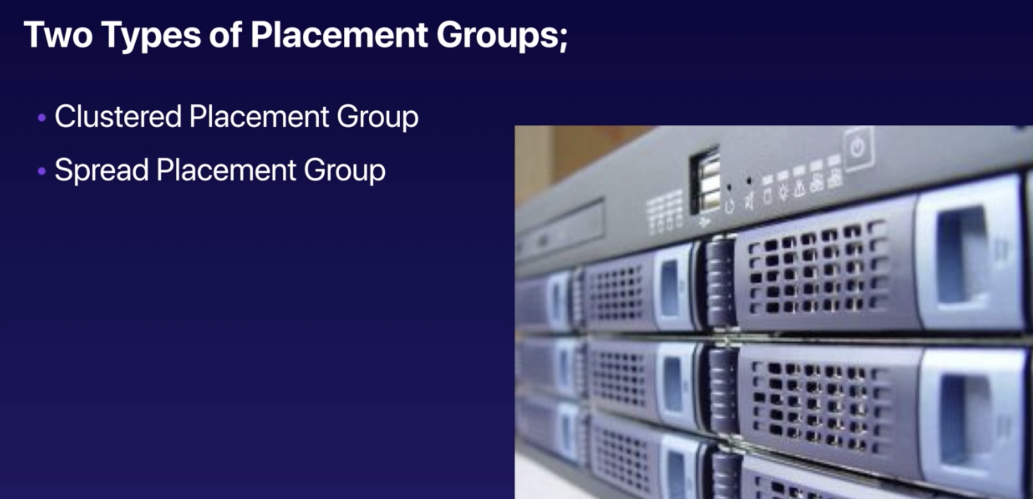
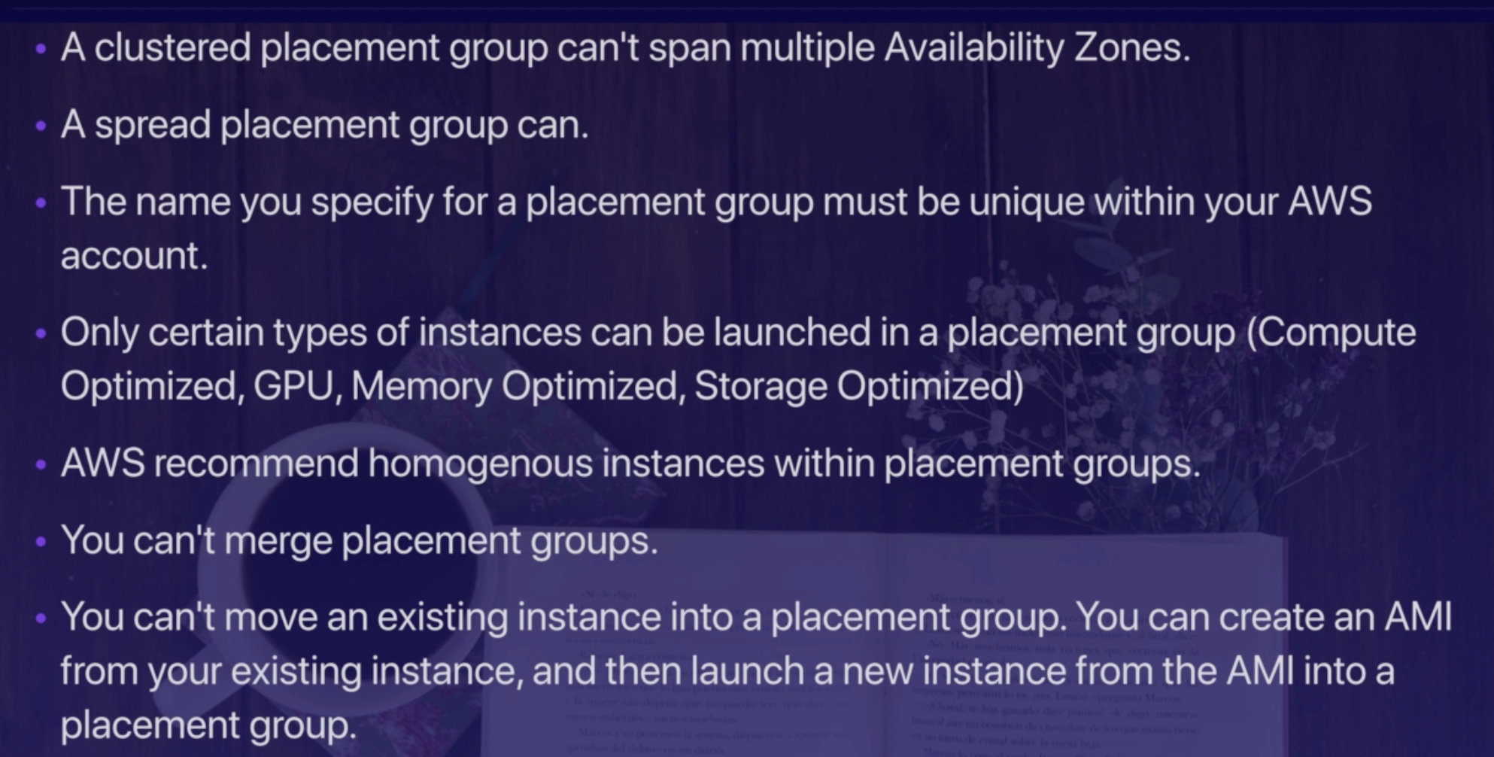
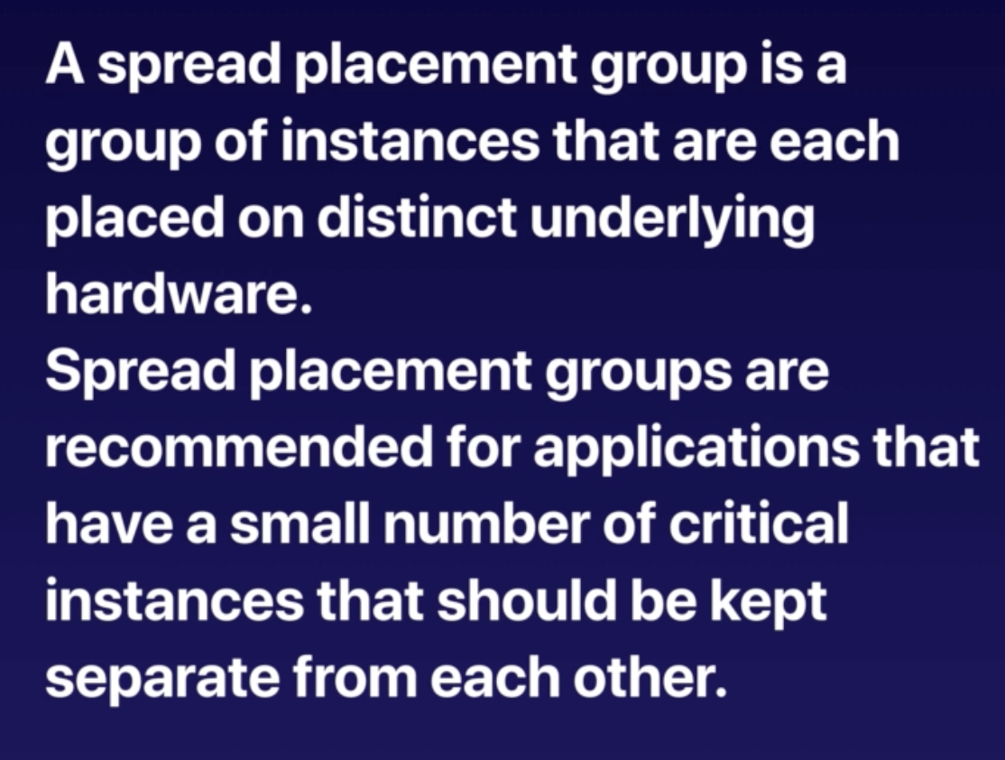
EC2 Placement Groups

Slide 11
SG VS NACL

Slide 12
SQS Vs SWF

Slide 13
Elastic Cache – Memcached Vs Redis

Slide 14
All DBS

Slide 15
EC2 Instance Types

Slide 16
Cloud watch Vs Cloud Trail

Slide 17
Encrypting Root Volume

Slide 18
Moving Volume from one AZ to Anathor AZ

Slide 19
EBS VS EFS

Slide 20
Pricing Models – EC2

